Slide 1
A comparison of explicit and implicit consumer identification with commercial and place brands
Sonia Capelli
Charlotte Lécuyer
University of Lyon - France
6th Consumer Brand Relationship Conference – May 21st 2019

Slide 2
Introduction
From the consumer’s perspective, such messages issue similar appeals to establish a connection between the self and the brand.
Yet marketing researchers tend to investigate these brands as two separate concepts: a commercial brand and a place brand.
We propose to compare CBI induced by commercial and place brands
Notes:
In the same advertising block

Slide 3



Theoretical Background
Consumer-brand identification
Social Identity theory (Tajfel & Turner, 1985)
2 Identification ways:
  Brand as partner : Consumers use brands to define who they are (Albert et al., 2013; Lam et al., 2010)
  Consuming brand to be part of a group who indentifies with the same brand (Lam et al., 2010)
Conditions for brands to achieve CBI
  Emotional attachment to the brand (Malar et al., 2011)
  Enhancing favorable consequences of the bond (Batra et al. 2012)
  Enhancing cognitive perception of the overlap (Bergami and Bagozzi, 2000; Stokburger-Sauer et al., 2012)
Notes:
people identify with social entities in their efforts to construct, validate, and signal their social identities. People define their social identity to strengthen their sense of self, based on their self-categorization as members or non-members of different groups in their social environment.
Brands ground social identity by two ways: in the consumer–brand relationship and in the relationship between consumers and their social groups (Escalas and Bettman, 2003). Customers use brands to define who they are (Albert et al., 2013; Lam et al., 2010), in the sense that brands can be considered partners. They also might consider themselves part of an in-group of customers who identify with the same brand (Lam et al., 2010) and construct a social self this way, by consuming such brands

Slide 4
Theoretical Background
Commercial brands vs place brands
 | Commercial brands Excluding consumers | Place brands Including consumers
Ownership | Owned by a private company | Owned by the place itself: public authority or democratically designed by the residents of the place.
Aim | Serving stakeholders’ financial interests | Serving the public good, including the interests of several stakeholders living in the place (local firms and residents)
Inclusion level of the target in the branded entity | Target excluded from the brand itself. Top down approach | Target is part of the brand creation process: Place is embodied in actors such as residents, local firms, tourists. Bottom-up approach
CBI as the “consumer's perceived state of oneness with a brand” (Stokburger-Sauer et al., 2012, p. 407)=> the brand’s ability to include consumers is at the core of CBI development
H1: Residents identify with place brands more strongly than with commercial brands
Notes:
people identify with social entities in their efforts to construct, validate, and signal their social identities. People define their social identity to strengthen their sense of self, based on their self-categorization as members or non-members of different groups in their social environment.
Brands ground social identity by two ways: in the consumer–brand relationship and in the relationship between consumers and their social groups (Escalas and Bettman, 2003). Customers use brands to define who they are (Albert et al., 2013; Lam et al., 2010), in the sense that brands can be considered partners. They also might consider themselves part of an in-group of customers who identify with the same brand (Lam et al., 2010) and construct a social self this way, by consuming such brands

Slide 5
Research Model
Focus on place brands
Place brands varie along their capacity to empower :
non-participative place brands: traditionnal place name and logo efforts
Participative place brands : Specific place brands dedicated to effective integrative marketing communications
H2: Residents identify with participative place brands more strongly than with non-participative place brands.
Focus on commercial brands
Commercial brands varie along their geographical proximity to consumer :
Global commercial brands
Local commercial brands
H3: Residents identify with local commercial brands more strongly than with global commercial brands.

Slide 6
Method
In this research, conducted in France, we selected region brands as the focal place brands.
A mixed method approach
Study 1: explicit CBI
Study 2: implicit CBI

Slide 7
Study 1: explicit CBI
Sample: 116 undergraduate students from university of Lyon (M_{age} = 20 years; 67% female).
To measure CBI, we used Liu and Cal’s (2011)
Results
Residents do not identify more strongly with place brands relative to commercial brands (M_{commercial} = 43; M_{place} = 38.5; t(102) = 2.98, p = .182), so we cannot confirm H1.
Residents do not identify significantly more strongly with participative place brands compared with non-participative place brands (M_{participative} =39.76; M_{non-participative} =39.76; t(69) = 6.72, p = .549), so we can not confirm H2
Contrary to our prediction in H3, respondents identify significantly more strongly with global commercial brands than with local commercial brands (M_{global} = 51.25; M_{local} = 18.35; t(47) = 7.22, p = .001).
Notes:
Residents do not identify more strongly with place brands relative to commercial brands (Mcommercial = 43; Mplace = 38.5; t(102) = 2.98, p = .182), so we cannot confirm H1
residents do not identify significantly more strongly with participative place brands compared with non-participative place brands (Mparticipative =39.76; Mnon-participative =39.76; t(69) = 6.72, p = .549)
Contrary to our prediction in H3, respondents identify significantly more strongly with global commercial brands than with local commercial brands (Mglobal = 51.25; Mlocal = 18.35; t(47) = 7.22, p = .001).

Slide 8
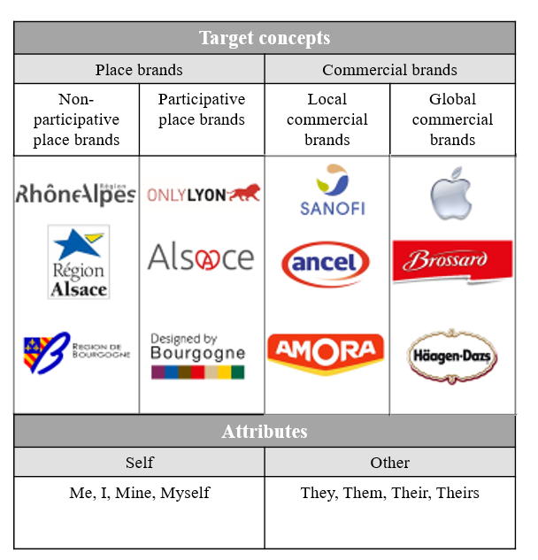
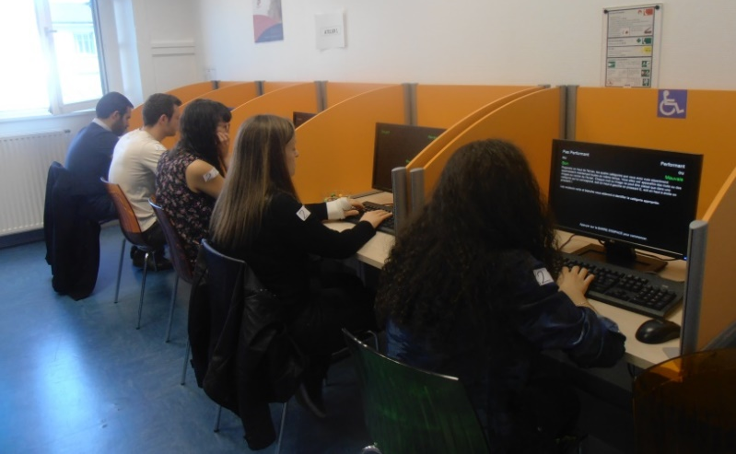
Study 2: Implicit CBI
Implicit Association Test
we examine the strength of the association between concepts (place/commercial brands) and attributes (self/other)
Sample
228 French undergraduate participants (Mage = 21 years, 56% female) came from three different universities, in three different French regions
Procedure

Slide 9
Study 2: Implicit CBI
Results
Contrary with our H1 prediction
Contrary with our H2 prediction
Contrary with our H3 prediction
Notes:
contrary to our expectations, that residents identify more strongly with commercial brands than with place brands (Mcommercial = 940 ms, Mplace = 1170 ms; t(96) = 1.26, p < .001, d = 0.57). they associate others more strongly with place brands than with commercial brands (Mcommercial = 790 ms, Mplace = 970 ms; t(196) = 1.53, p < .001, d = 4.2). That is, residents identify themselves better with commercial brands (global and local) than with place brands (participative and non-participative), contrary with our prediction in H1.
residents identify more strongly with non-participative place brands than with participative place brands (Mnon-participative = 970 ms, Mparticipative = 1160 ms; t(95) = 2.9, p < .001, d = 0.67); opposite to H2
for commercial brands, the results show that global brands generate more identification for residents than do local brands (Mglobal = 805 ms, Mlocal = 890 ms; t(95) = 1.2, p < .001, d = 1.01). Here again, we find a result that is the reverse of our prediction in H3 when we investigate implicit CBI.

Slide 10
Academic contributions
Most studies measure CBI explicitly. We propose an original measure, based on an IAT, to access implicit CBI.
We confirm a dissociation between explicit and implicit results: self-reported identification with a region might be masked, potentially by factors such as resident role playing.
We discern that geographical proximity might not be the best way to enhance CBI. Value-based identification developed by strong global commercial brands encourages more consumer identification.
If most place branding studies advocate the use of branding strategies to support place attractiveness; our results indicate that parallel approaches for CBI are not obvious.
Notes:
Most studies measure CBI explicitly, as a unidimensional (e.g., Stokburger-Sauer et al., 2012) or multidimensional (e.g., Bagozzi et al., 2012; Berropze et al. 2019; Lam et al., 2013) construct. We propose an original measure, based on an IAT, that uses self and other as anchors; it offers an alternative to classical assessments of attitudes in marketing With regard to brand identification, a previously unexplored topic, we confirm a dissociation between explicit and implicit results, which implies that self-reported identification with a region might be masked, potentially by factors such as resident role playing (Weber and Cook, 1972). As parts of the territory, residents might explicitly express affiliation to the place, but the implicit results from our study show that they do not identify strongly with place brands, relative to commercial brands.
we discern that geographical proximity might not be the best way to enhance CBI. Value-based identification developed by strong global commercial brands encourages more consumer identification . Previous research into explicit preferences for global and local brands clarifies that perceived brand localness operates mainly through brand identity expressiveness, whereas perceived brand globalness affects behavioral intentions through the pathways of brand prestige, trust, and affect (Xie et al., 2015). On the contrary, the results of the present research, using both explicit and implicit methods, stress that global brands produce more CBI than local brands.
this research contributes to debates about the use of commercial marketing tactics for public management (Kotler and Gentler, 2002). Most place branding studies advocate the use of branding strategies to support place attractiveness (Ashworth and Kavaratzis, 2009); our results indicate that parallel approaches for places and commercial brands are not obvious to consumers.

Slide 11
Managerial contributions
The results advocate for the use of values to create CBI. Geographical proximity created by values linked to the place is not sufficient to enhance identification.
Global commercial brands enhance CBI better than local commercial brands.
The results question the participative place brand ability to create CBI
Notes:
Global commercial brands enhance CBI better than local commercial brands. For example, if Toyota claims a local anchoring and increases its local production unities with European markets, it is unlikely to increase European consumers’ identification with Toyota; rather, its resonance with ecological values, due to its development of hybrid cars, seems sufficient to encourage CBI among environmentally conscious consumers around the world. Claiming a local anchoring still may convince consumers, but it does not work through identification with the brand.
Quand tu es une marque global, tu as plus intérêt à te baser sur tes valeurs de marque globale plutôt que parler local (exemple toyota)

Slide 12
A comparison of explicit and implicit consumer identification with commercial and place brands
Sonia Capelli
Charlotte Lécuyer
University of Lyon - France
6th Consumer Brand Relationship Conference – May 21st 2019

